Slide 1
VEHICLE INTERACTION CONTROL IMPROVEMENT
Surface Functional Performance Scenario Storyboards

Slide 2
What are scenario storyboards?
The Functional Performance Scenario Storyboard approach was developed by an EMESRT Member Company to better understand the fatal vehicle interaction scenarios in a surface mine and to then compare the capability of vehicle interaction technologies to mitigate or eliminate the exposures detailed in the storyboards. This has enabled designers to better develop and install vehicle interaction technologies appropriate mobile equipment interactions at surface mines and recently adapted for Underground mines
They provide a visual and dynamic reference for equipment operators, technology suppliers, Vehicle Interaction Control Improvement project managers as they implement vehicle interaction intervention controls (EMESRT Levels 7, 8 and 9)
How can I use the scenario storyboards?
Once downloaded, review each Storyboard in presentation mode
Use the Storyboards as a resource during Phase 4 – Vehicle Interaction Control Enhancement
As required, apply the specific scenario storyboards in your functional performance environment context to derive the configuration settings
Generally, in the storyboards these definitions apply:
LO = Local Object (causing the interaction)
RO = Remote Object (affected by the interaction)
Adapting and Using the Storyboards

Slide 3
User interface behaviour – vehicle to vehicle interaction
Nil Interaction
No VI event audibles
No detection beams visible
Alert
Occurs when outer to outer or inner to outer/outer to inner beams on two vehicles intersect
User interface zooms to the interaction
Detection beams on both vehicles turn yellow then red
Default audible message of “Alert” is activated, definitive audibles used for specific VI scenarios
Audible played twice then a 3 second gap and repeated until situation rectified
Audible played at 5 dB above ambient noise
Alarm
Occurs when inner beam intersects with inner beam or body of another vehicle
User interface remains bright and zoomed to the interaction
Detection beams on both vehicles remain red
Default audible of “Shrill”, “Stop”, definitive audibles used for specific VI scenarios
Audible without the “Shrill” repeated with 1.5 second gap until situation rectified
Audible played at 10 dB above ambient noise
NOTE: the text in red provides examples of parameters that should be considered during development and site configuration.

Slide 4
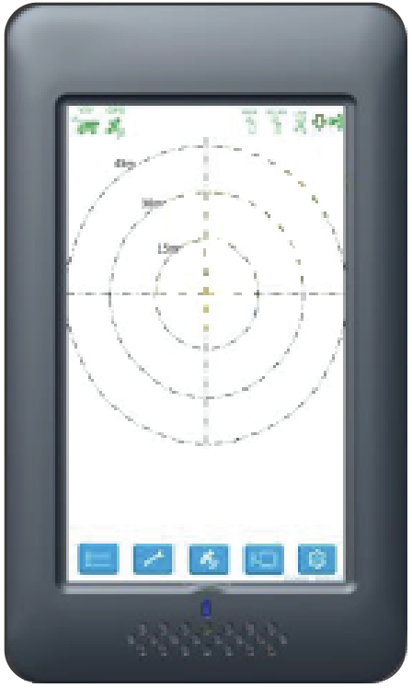
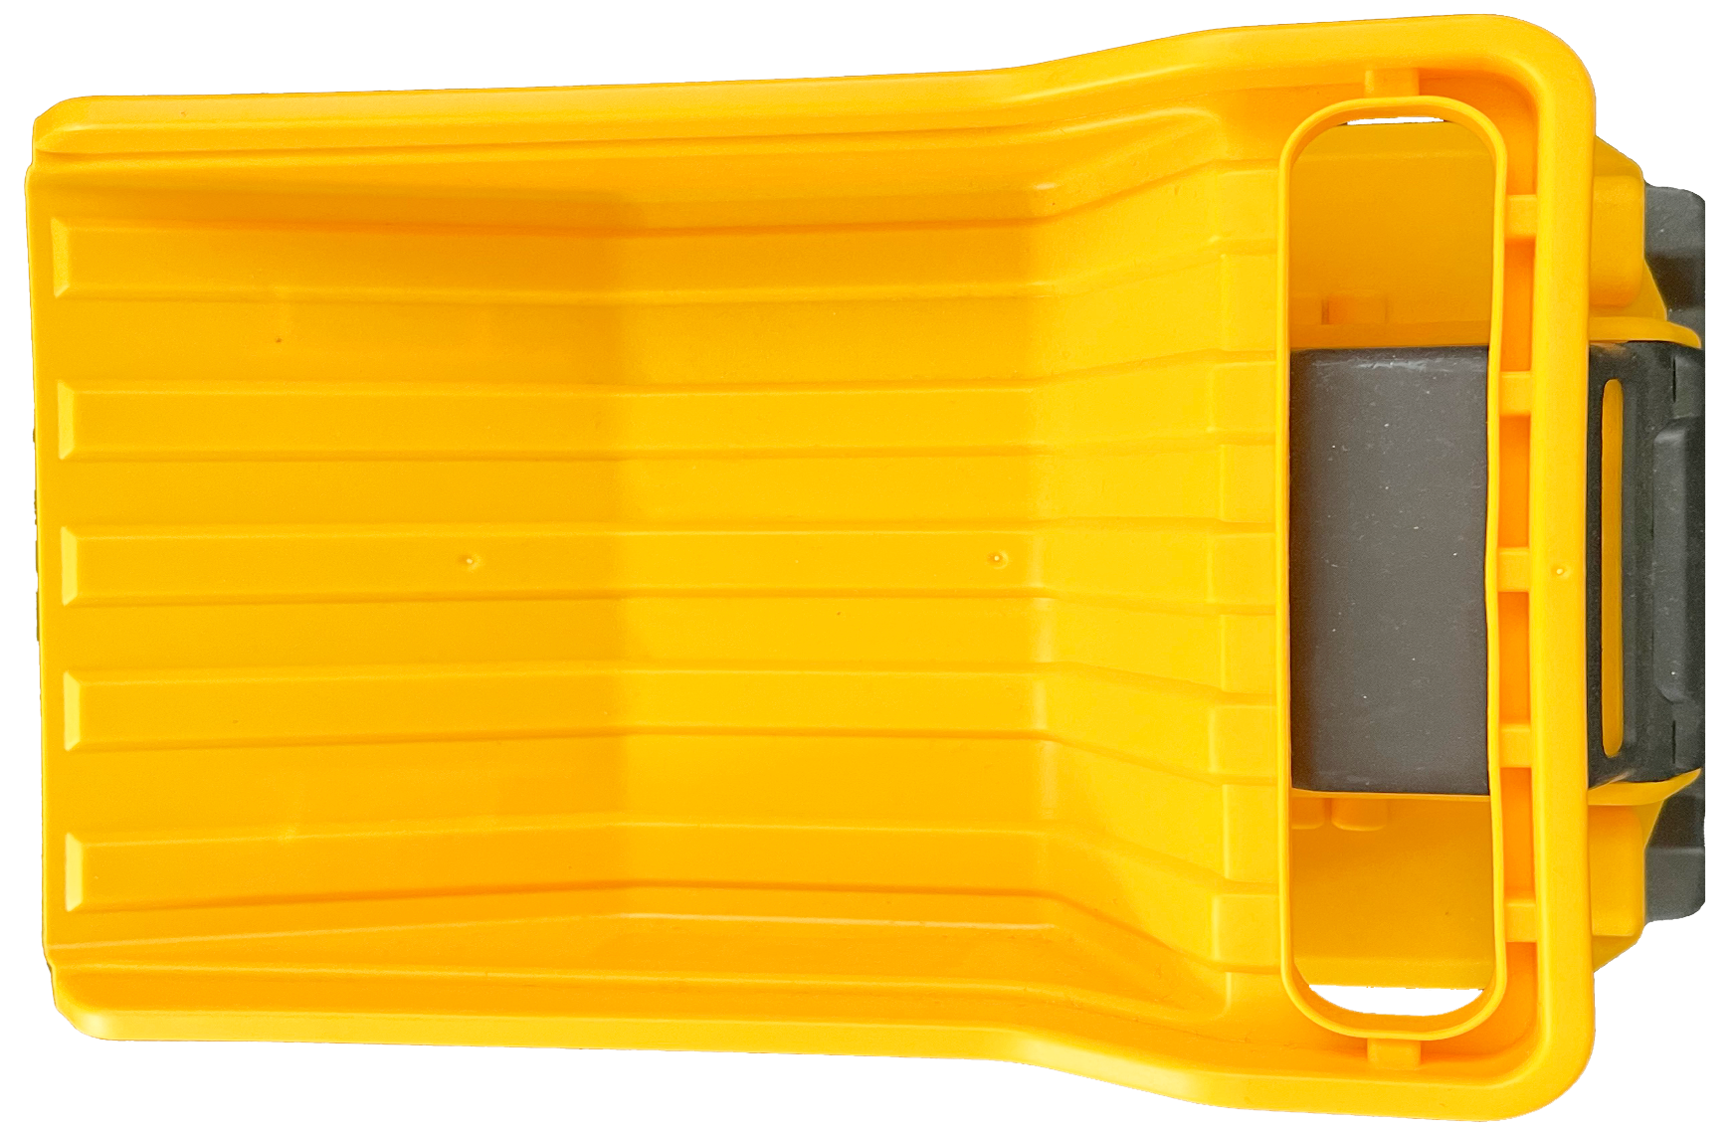
Scenario 2A: Speeding
Awareness – not required
Alert – If the LO’s speed is above X% (i.e., 10%) when the inner beam breaches the geo-fence the user interface will brighten and an audible message of “Speed Zone Ahead” will be activated once only. If the vehicle is travelling below the required speed no prompts will occur. The speed limit icon will appear on the user panel.
Alarm - If the LO’s speed is still above X% (i.e., 10%) when the body of the LO breaches the speed zone geo-fence an audible message of “Reduce Speed” will be activated, repeating with a 5 second gap until speed limit is met
Grace period of X seconds (i.e., 5-10 secs) will be given to operator to reduce their speed within tolerance prior to a speeding event being registered
Note: If the vehicle is travelling below the required speed no prompts will occur.
Applicable for all vehicles.
40 Kph
60 Kph
60 Kph
“SPEED ZONE AHEAD”
“SPEED ZONE AHEAD”
NOTE: the text in red provides examples of parameters that should be considered during development and site configuration.

