Slide 1
VEHICLE INTERACTION CONTROL IMPROVEMENT
Surface Functional Performance Scenario Storyboards

Slide 2
What are scenario storyboards?
The Functional Performance Scenario Storyboard approach was developed by an EMESRT Member Company to better understand the fatal vehicle interaction scenarios in a surface mine and to then compare the capability of vehicle interaction technologies to mitigate or eliminate the exposures detailed in the storyboards. This has enabled designers to better develop and install vehicle interaction technologies appropriate mobile equipment interactions at surface mines and recently adapted for Underground mines
They provide a visual and dynamic reference for equipment operators, technology suppliers, Vehicle Interaction Control Improvement project managers as they implement vehicle interaction intervention controls (EMESRT Levels 7, 8 and 9)
How can I use the scenario storyboards?
Once downloaded, review each Storyboard in presentation mode
Use the Storyboards as a resource during Phase 4 – Vehicle Interaction Control Enhancement
As required, apply the specific scenario storyboards in your functional performance environment context to derive the configuration settings
Generally, in the storyboards these definitions apply:
LO = Local Object (causing the interaction)
RO = Remote Object (affected by the interaction)
Adapting and Using the Storyboards

Slide 3
User interface behaviour – vehicle to vehicle interaction
Nil Interaction
No VI event audibles
No detection beams visible
Alert
Occurs when outer to outer or inner to outer/outer to inner beams on two vehicles intersect
User interface zooms to the interaction
Detection beams on both vehicles turn yellow then red
Default audible message of “Alert” is activated, definitive audibles used for specific VI scenarios
Audible played twice then a 3 second gap and repeated until situation rectified
Audible played at 5 dB above ambient noise
Alarm
Occurs when inner beam intersects with inner beam or body of another vehicle
User interface remains bright and zoomed to the interaction
Detection beams on both vehicles remain red
Default audible of “Shrill”, “Stop”, definitive audibles used for specific VI scenarios
Audible without the “Shrill” repeated with 1.5 second gap until situation rectified
Audible played at 10 dB above ambient noise
NOTE: the text in red provides examples of parameters that should be considered during development and site configuration.

Slide 4
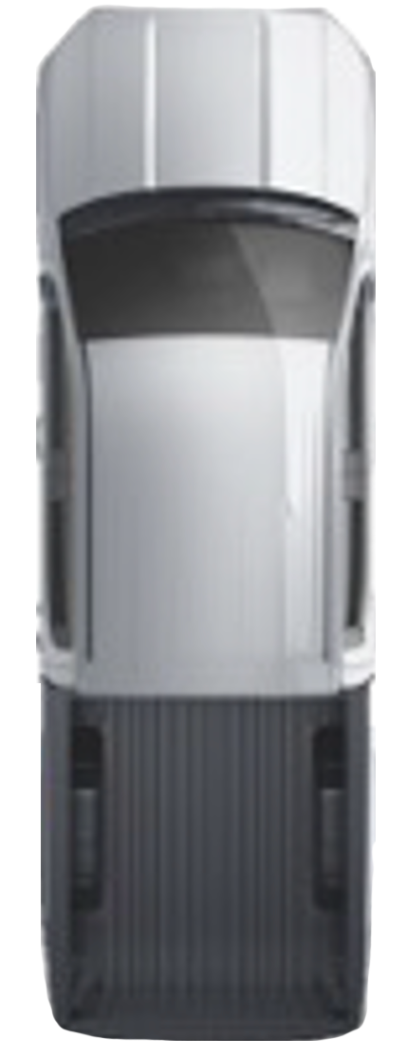
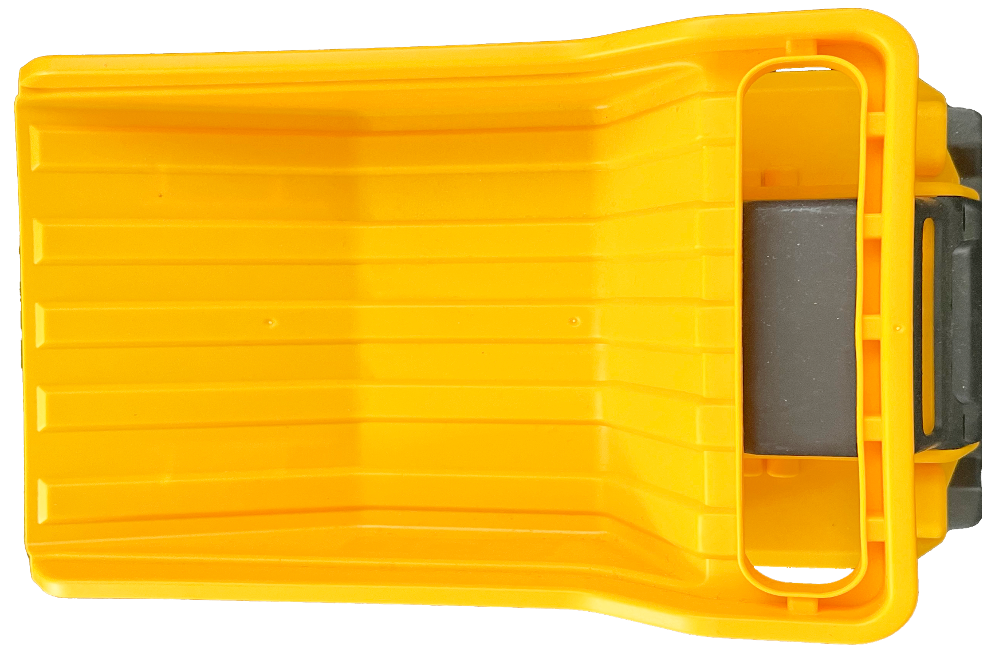
Scenario 7A: Passing stationary heavy vehicle – dump and dig face
LV operator needs to enter within 30 m of HV to pass
LV operator needs to perform the following once in range of HV (300 m V2X)
Operator touches the specific HV icon on the user interface
Selects the “Pass button”
HV user screen brightens and receives audible message “Pass Request”
“Accept or Reject” button appears on user interface
Message appears on user interface “LV ID # would like to pass”
HV cannot press the “Accept” button until safe state is achieved, “Reject” button can be pressed
HV engages safe state controls, if not already
Yellow safe state broadcast to all vehicles in range
HV authorises LV to pass by pressing “Accept” button
Green safe state broadcast only to authorised LV
User interface will display a graphical representation in both vehicles, LV is now authorised to enter zone to pass (relevant for that interaction only – timeout after 60 secs)
If any condition of the safe state is broken during passing, approval on both vehicles is void and an event is triggered with an audible message of “Breach” on the LV and “Don’t Move” on the HV
Accept
REJECT
LV #1 WANTS TO PASS
RO = HV
O Kph
Neutral
Brake Set
LO = LV
PASS
ACCESS
Not applicable for LV to LV & MV interactions nor MV to MV & LV interactions nor tracked loading unit to tracked loading unit interactions.
30 metre zone must be visible on all user interface at all times when the vehicle is stationary (red), in a safe state (yellow). An acknowledged safe state (green) will only be visible to the two vehicles that are interacting.
NOTE: the text in red provides examples of parameters that should be considered during development and site configuration.

