Slide 1
Vehicle interaction control improvement project
Underground functional performance scenario storyboards
Scenario 1: Pedestrian approaching static Vehicle
Tier 1
Tier 2
EMESRT Members

Slide 2
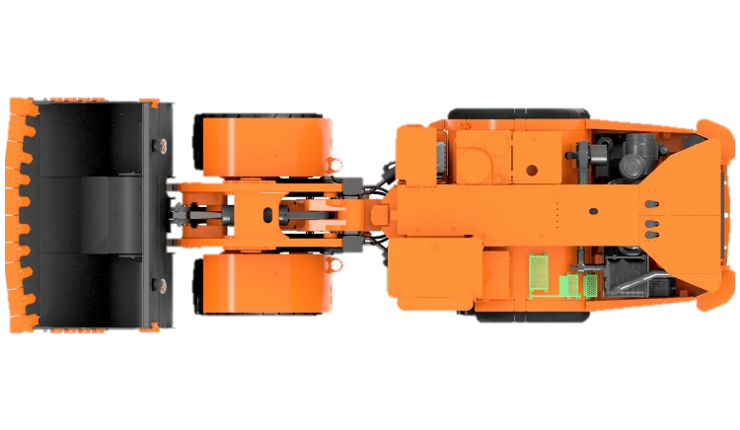
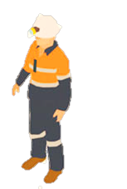
Scenario 1
Pedestrian approaching static Vehicle
Operator is unaware of Pedestrian
LO –> A2 Alert
LO –> A1 Awareness
FINISHED
ANIMATING
LO –> A3 Alarm
START ANIMATION
CLICK AGAIN
LO is stationary, in a Safe State, with an operator in the cab
Pedestrian approaches the LO to typical A3 Alarm distance
LO receives A1 Awareness
Operator is unaware of Pedestrian and intends to move LO vehicle
LO is stationary, in an Unsafe State
Pedestrian approaches the LO ignorant of Unsafe State
LO receives A1 Awareness
LO is stationary, in a Safe State, with an operator in the cab
Pedestrian approaches the LO to typical A3 Alarm distance
LO receives A1 Awareness
Operator is unaware of Pedestrian and intends to move LO vehicle
Pedestrian continues approach
A2 Alert Triggered on entry of A2 Zone
LO Operator alerted to abnormal situation
LO Operator disables Safe State
LO Operator immediately receives A3 Alarm
LO Operator disables Safe State
LO Operator immediately receives A3 Alarm
Pedestrian continues to approach, ignorant of Unsafe State
A3 Alarm Triggered on entry of 2nd Zone
Alarm notifies LO Operator of imminent threat
Theoretical trigger for L9 Control
Operator placing LO Vehicle in Safe State should silence A2 Alert and A3 Alarm. A1 Awareness should always be available.
Common Variations
LO at Go-Line with other LO Drivers in Proximity

Slide 3
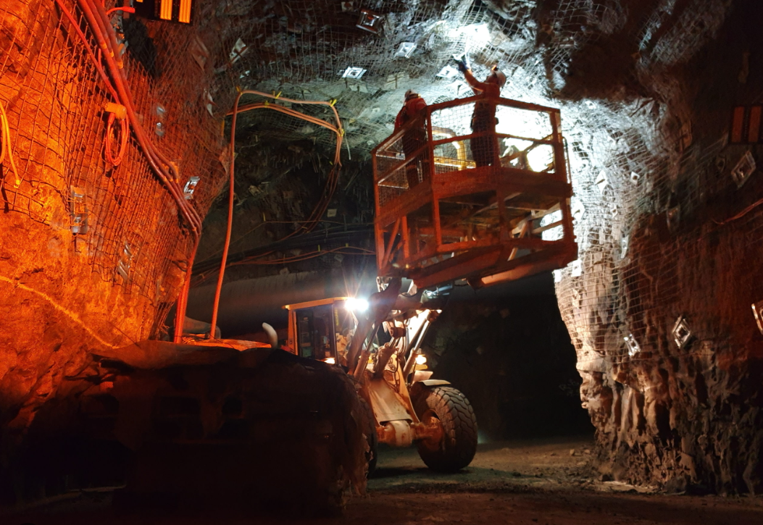
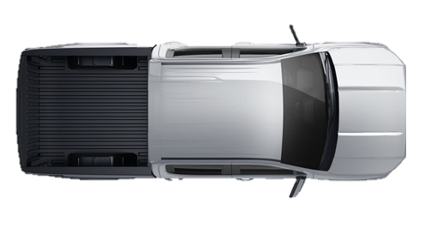
Failure Mode 1 – False/Failed Trigger
Occupants in vehicle and in close proximity
A3 Alarm
No Alarm
Vehicles occupants causes system to trigger A3 alarm, believing there is a pedestrian outside the vehicle.
Pedestrian outside the vehicle is detected as an occupant of the vehicle and therefore does not trigger alarm.
Consideration must be given for activities that involve pedestrians working in close proximity to machines.
Example:
Pedestrians performing inspections of machines at go line.
Pedestrian under vehicle or in close proximity to the machine are not detected and therefore does not trigger alarm.

Slide 4
Vehicle Interaction Control Improvement Project
Underground Functional Performance Scenario Storyboards
Scenario 2: Vehicle moving towards a Person / Equipment / Vehicle
Tier 1
Tier 2
EMESRT Members

Slide 5
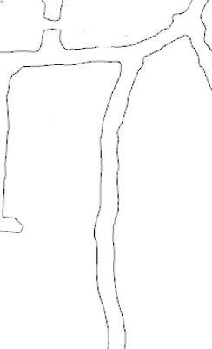
Scenario 2
Vehicle moving towards a Person / Equipment / Vehicle
or
LO –> A3 Alarm
LO –> A2 Alert
LO –> A1 Awareness
FINISHED
ANIMATING
START ANIMATION
LO approaching pedestrian or LV (RO) in a roadway
Operating state of LO is visible to RO
RO has A1 Awareness on approach
Example Parameters to Consider:
Mass of Machine
Operating Speed of Machine
Grade of the Drive
A2 Alert Triggered on entry of 1st Zone
LO Operator alerted to abnormal situation
A3 Alarm Triggered on entry of 2nd Zone
Alarm notifies LO Operator of imminent threat
Theoretical trigger for L9 Control
Inactive Vehicle
Consideration should be given to the variation of this scenario involving a pedestrian behind an inactive vehicle. The LO should still detect the RO behind the vehicle and ensure that the inactive vehicle is not “pushed” onto the RO.
Common Variations
LO Reversing into RO
RO is moving as LO Approaches
LO approaching a workshop or service bay
Underground tunnels are rarely perfectly straight. Consideration must be given for the constant change in shape of the tunnel. Additionally, the tunnel may not be flat, but may dip or crest.

Slide 6
Vehicle interaction control improvement project
Underground functional performance scenario storyboards
Scenario 3: Two vehicles approaching each other
Tier 1
Tier 2
EMESRT Members

Slide 7
Scenario 3
Two vehicles approaching each other
LO –> A3 Alarm
RO –> A1 Awareness
LO –> A2 Alert
RO –> A3 Alarm
LO –> A1 Awareness
FINISHED
RO –> A2 Alert
ANIMATING
START ANIMATION
LO approaching RO in a roadway
Intention is for both vehicles to continue on straight course
Operating state of LO is visible to RO and vice versa
RO has A1 and LO has A1 Awareness on approach
Example Parameters to Consider:
Mass of the Machines
Operating Speed of Machines
Grade of the Drive
A2 Alert Triggered on entry of 1st Zone on both RO and LO
RO and LO Operator alerted to abnormal situation
A3 Alarm Triggered on entry of 2nd Zone on both RO and LO
Alarm notifies RO and LO Operator of imminent threat
Theoretical trigger for L9 Control
Common Variations
Head to Head, Head to Tail and Tail to Tail
RO is moving or stationary as LO Approaches
Underground tunnels are rarely perfectly straight. Consideration must be given for the constant change in shape of the tunnel.
Additionally, the tunnel may not be flat, but may dip or crest.

Slide 8
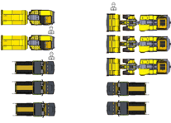
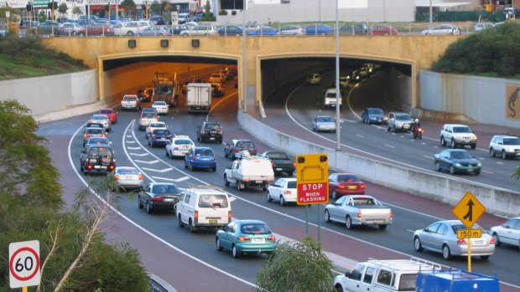
Failure Mode 2 – False Trigger
Congestion
LO –> A3 Alarm
FINISHED
ANIMATING
START ANIMATION
Multiple vehicles seeking to perform similar maneuver
Portal access, key intersection, go line exit
One or more LO’s approaching one or more RO’s
LO and RO has A1 Awareness on approach
Depending on level of proximity achieved by each vehicle
A2 Alert Triggered on entry of 1st Zone
LO Operator alerted to abnormal situation
A3 Alarm Triggered on entry of 2nd Zone
Alarm notifies LO Operator of imminent threat
Theoretical trigger for L9 Control
Congestion can occur at key locations in a mine where multiple vehicles are waiting to proceed.
Consideration should be given to allowing vehicles to queue in close proximity and move forward once able to.
Common Variations
Portal Access
Heavy Vehicle Go Lines
Light Vehicle parking bays
Key intersections through mine
Workshops and Maintenance Bays
Lunch rooms and Refuge Stations

Slide 9
Vehicle interaction control improvement project
Underground functional performance scenario storyboards
Scenario 4: Vehicle turning towards a Person / Equipment / Vehicle
Tier 1
Tier 2
EMESRT Members

Slide 10
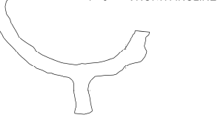
Scenario 4
Vehicle turning towards a Person / Equipment / Vehicle
LO –> A3 Alarm
LO –> A2 Alert
LO –> A1 Awareness
FINISHED
ANIMATING
START ANIMATION
LO approaching turn with pedestrian or LV (RO) in a roadway
Operating state of LO is visible to RO
RO A1 Awareness on approach
Example Parameters to Consider:
Mass of Machine
Operator Speed of Machine
Grade of the Drive
Turning speed of machine
or
A2 Alert Triggered on entry of 1st Zone as turn is initiated
LO Operator alerted to abnormal situation
A3 Alarm Triggered on entry of 2nd Zone as turn is continued
Alarm notifies LO Operator of imminent threat
Theoretical trigger for L9 Control
Turns are not always 90 degrees. Consideration must be given for turns that have acute angles
Common Variations
LO Reversing into RO through a turn
RO is moving as LO Approaches
T Intersection, Cross Intersection, Simple Sharp Turn
A turn point does not always occur on a straight path. Consideration must be given to the possibility that the machine was already performing a turn (to maintain tunnel direction) before the turn at the intersection.

Slide 11
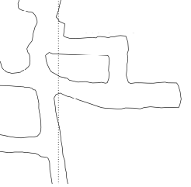
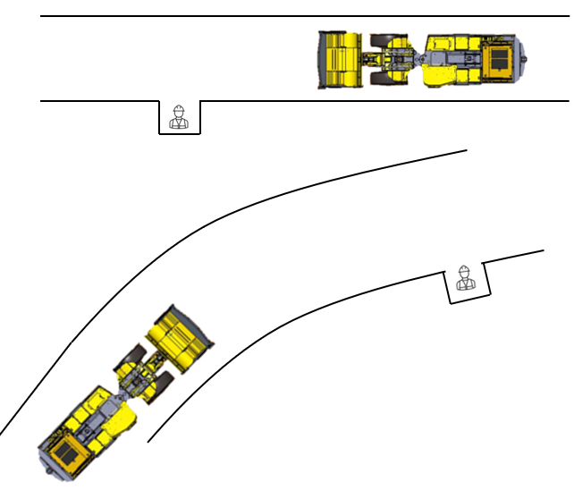
Failure Mode 3 – False Trigger
Vehicle passing occupied T-intersection
Intended Direction of Travel
LO –> A3 Alarm
LO –> A2 Alert
LO –> A1 Awareness
FINISHED
ANIMATING
START ANIMATION
LO approaching pedestrian or LV (RO) in a roadway
Intention is to continue on straight course
Operating state of LO is visible to RO
RO A1 Awareness on approach
or
Consideration should be given to vehicles passing in close proximity to areas that normally have pedestrians working.
Crib Room
False A2 Alert Triggered – Zone expanding into Intersection
LO Operator falsely alerted to normal situation
False A3 Alarm Triggered – Zone expanding into Intersection
Alarm falsely notifies LO Operator of imminent threat
Theoretical false trigger of L9 Control
Common Variations
LO Reversing past intersection
RO is moving as LO Approaches
Applicable to T Intersection, Cross Intersection or on a curved drive
Applicable to Crib Rooms, Workshops and Work Bays
Applicable to pedestrian safety bays
A turn point does not always occur on a straight path. Consideration should be given to the possibility that the machine was already performing a turn (to maintain tunnel direction) before the turn at the intersection.

Slide 12
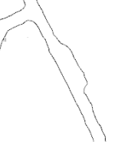
Failure Mode 4 – False Trigger
Vehicle passing occupied passing bay
Intended Direction of Travel
LO –> A3 Alarm
LO –> A2 Alert
LO –> A1 Awareness
FINISHED
ANIMATING
START ANIMATION
LO approaching vehicle in passing bay
Intention is to continue on straight course
Operating state of LO is visible to RO
RO A1 Awareness on approach
Example Parameters to Consider:
Mass of Machine
Operating Speed of Machine
Stopping Distance of Machine
Width of the Drive
False A2 Alert Triggered – Zone expanding into passing bay
LO Operator falsely alerted to normal situation
False A3 Alarm Triggered – Zone expanding into passing bay
Alarm falsely notifies LO Operator of imminent threat
Theoretical false trigger of L9 Control
Consideration must be made for the available space in the underground environment. Passing bays typically have sufficient room for two large vehicles and no more.
Common Variations
LO Reversing past intersection
RO is moving as LO Approaches
Applicable to curved drives

Slide 13
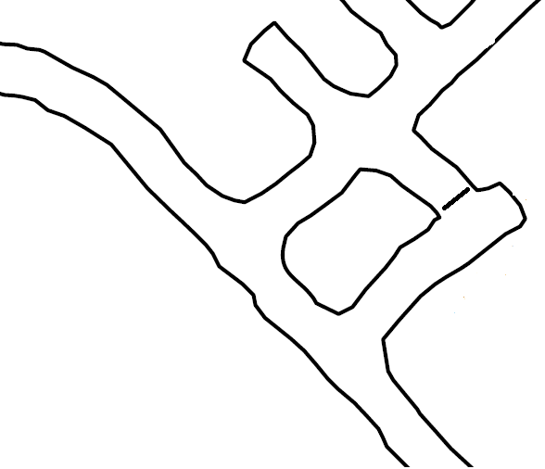
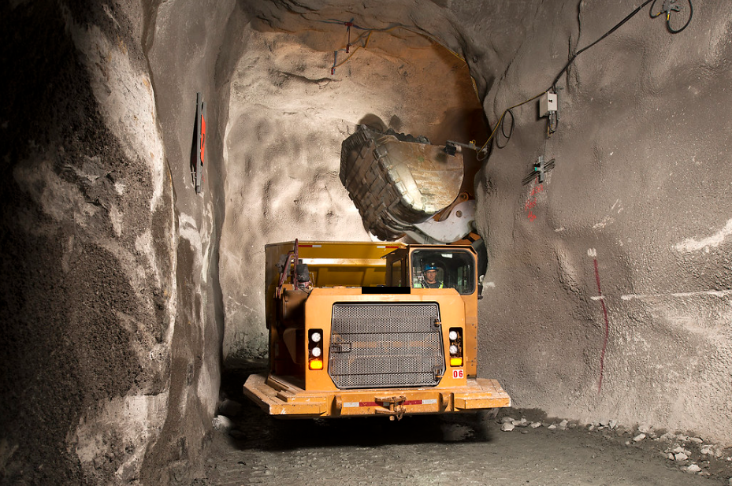
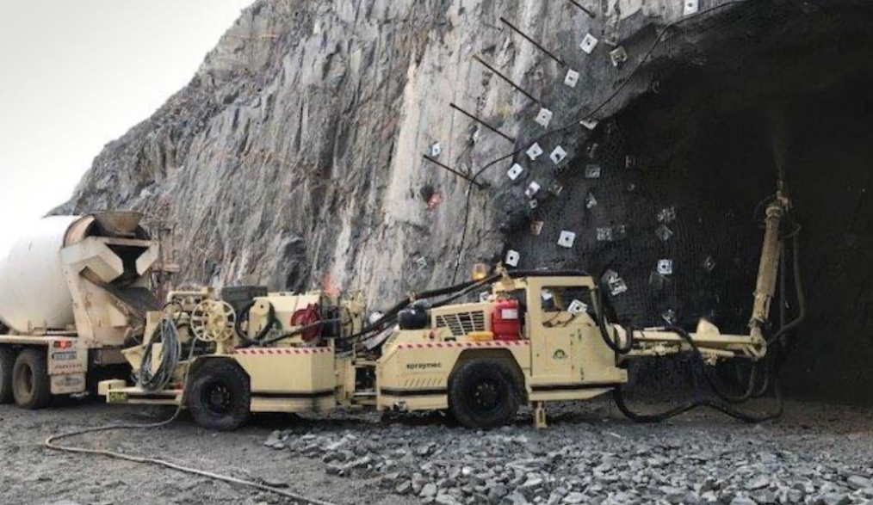
Failure Mode 5 – False Trigger
Vehicle deliberately approaching another vehicle
LO –> A3 Alarm
LO –> A2 Alert
LO –> A1 Awareness
FINISHED
ANIMATING
START ANIMATION
LO intentionally approaching RO in a roadway
Intention is to approach and stop at short proximity
Operating state of LO is visible to RO
RO A1 Awareness on approach
LHD
False A2 Alert Triggered
LO Operator falsely alerted to normal situation
LV
Truck
False A3 Alarm Triggered
Alarm falsely notifies LO Operator of imminent threat
Theoretical false trigger of L9 Control
Trucks can be loaded at the same grade or in dedicated Truck Loading Bays where the truck is lower than the loader. For the latter, consideration must be made for the normal circumstance where other vehicles can pass the truck.
Common Variations
LO is Reversing on approach
Applies to “at grade” loading and dissimilar grade loading
Truck can be loaded from side or rear
Common Examples
LHD loading a Truck
Agitator transferring to Shotcrete Spray Rig
Service Vehicle performing a service on HV
Fuel Truck approaching to Fuel
HV reversing to HV to attach for Towing

Slide 14
Vehicle interaction control improvement project
Underground functional performance scenario storyboards
Scenario 5: Vehicle approaching Environment hazard
Tier 1
Tier 2
EMESRT Members

Slide 15
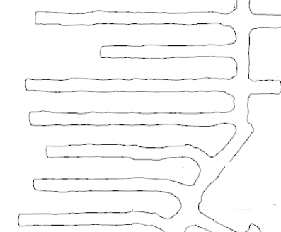
Scenario 5
Vehicle approaching Environment hazard
LO –> A3 Alarm
LO –> A2 Alert
LO –> A1 Awareness
FINISHED
ANIMATING
START ANIMATION
LO approaching hazard
RO A1 Awareness on approach
Example Parameters to Consider:
Mass of Machine
Operating Speed of Machine
Grade of the drive
A2 Alert Triggered on hazard entry of 1st Zone
LO Operator alerted to abnormal situation
A3 Alarm Triggered on entry of 2nd Zone
Alarm notifies LO Operator of imminent threat
Theoretical trigger for L9 Control
For mining operations that utilise Stope Extraction techniques, dangerous ground zones behind barricades are numerous, with multiples per level. Consideration must be given to the number of zones at the operation.
Common Variations
LO Approaching open stop or pass
LO approaching unsupported ground
LO approaching sump
LO approaching critical infrastructure such as electrical substations
LO approaching temporary installations (drills)

Slide 16
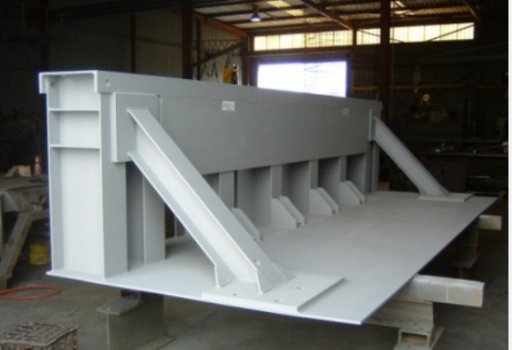
Failure Mode 6
Vehicle deliberately approaching hazard
LO –> A3 Alarm
LO –> A2 Alert
LO –> A1 Awareness
FINISHED
ANIMATING
START ANIMATION
LO is intentionally approaching hazard to perform work
RO A1 Awareness on approach
For mining operations that utilise Stope Extraction techniques, stop logs are numerous and portable, being shifted from stope to stope at the completion of backfill. Backfill activities can have a short duration, measured in days.
False A2 Alert Triggered
LO Operator falsely alerted to normal situation
False A3 Alarm Triggered
Alarm falsely notifies LO Operator of imminent threat
Theoretical false trigger of L9 Control
Common Variations
LO approaching tipping point with stop log or grizzly
LO approaching dangerous ground to park or give way to another vehicle
LO mucking out sump

Slide 17
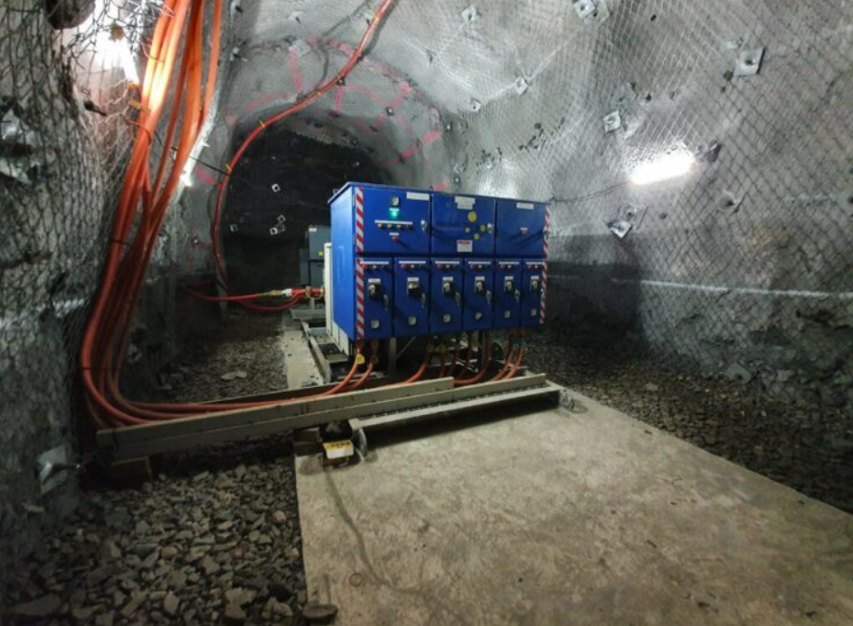
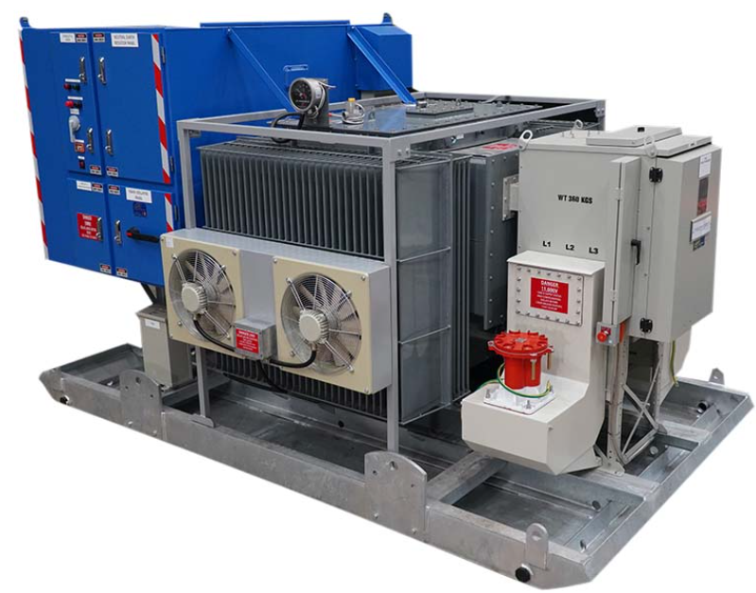
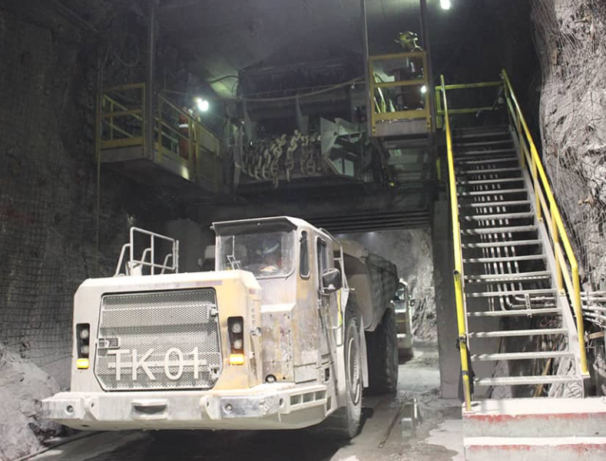
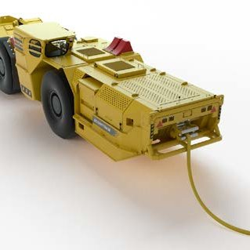
Failure Mode 7
Infrastructure or mobile vehicle effects on sensor capabilities
No Alarm
FINISHED
ANIMATING
START ANIMATION
LO approaching pedestrian or LV (RO) in a roadway
RO is in close proximity to infrastructure
Infrastructure influences sensor systems on LO
Operating state of LO is visible to RO
LO does not receive A1 Awareness on approach
A2 Alert or A3 Alarm are not triggered
Common Variations
LO operating near electrical infrastructure
LO operating near significant steel structure
LO operating in ore body with high levels of metals
Consideration should be made for the effects that battery electric or hybrid vehicles may have on certain sensor types.
Consideration should be made for the types of infrastructure underground that may affect certain sensor types.

Slide 18
End.
enquiries.org
emesrt.org

