Slide 1
Vehicle interaction control improvement project
Underground functional performance scenario storyboards
Scenario 1: Pedestrian approaching static Vehicle
Tier 1
Tier 2
EMESRT Members

Slide 2
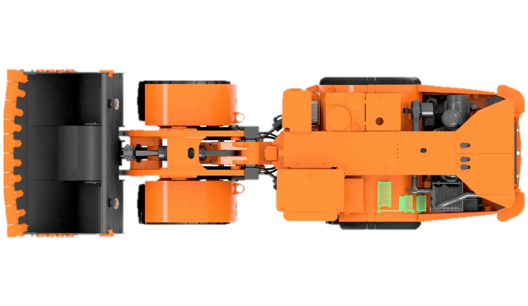
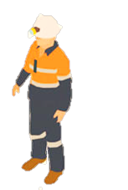
Scenario 1
Pedestrian approaching static Vehicle
Operator is unaware of Pedestrian
LO –> A2 Alert
LO –> A1 Awareness
FINISHED
ANIMATING
LO –> A3 Alarm
START ANIMATION
CLICK AGAIN
LO is stationary, in a Safe State, with an operator in the cab
Pedestrian approaches the LO to typical A3 Alarm distance
LO receives A1 Awareness
Operator is unaware of Pedestrian and intends to move LO vehicle
LO is stationary, in an Unsafe State
Pedestrian approaches the LO ignorant of Unsafe State
LO receives A1 Awareness
LO is stationary, in a Safe State, with an operator in the cab
Pedestrian approaches the LO to typical A3 Alarm distance
LO receives A1 Awareness
Operator is unaware of Pedestrian and intends to move LO vehicle
Pedestrian continues approach
A2 Alert Triggered on entry of A2 Zone
LO Operator alerted to abnormal situation
LO Operator disables Safe State
LO Operator immediately receives A3 Alarm
LO Operator disables Safe State
LO Operator immediately receives A3 Alarm
Pedestrian continues to approach, ignorant of Unsafe State
A3 Alarm Triggered on entry of 2nd Zone
Alarm notifies LO Operator of imminent threat
Theoretical trigger for L9 Control
Operator placing LO Vehicle in Safe State should silence A2 Alert and A3 Alarm. A1 Awareness should always be available.
Common Variations
LO at Go-Line with other LO Drivers in Proximity

Slide 3
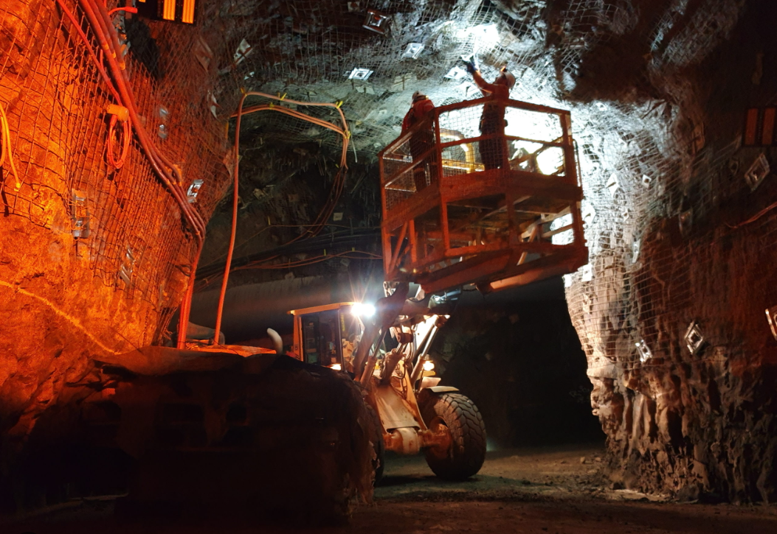
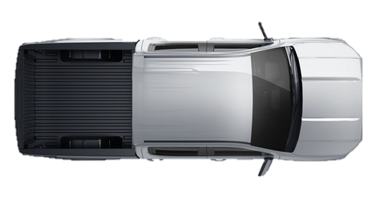
Failure Mode 1 – False/Failed Trigger
Occupants in vehicle and in close proximity
A3 Alarm
No Alarm
Vehicles occupants causes system to trigger A3 alarm, believing there is a pedestrian outside the vehicle.
Pedestrian outside the vehicle is detected as an occupant of the vehicle and therefore does not trigger alarm.
Consideration must be given for activities that involve pedestrians working in close proximity to machines.
Example:
Pedestrians performing inspections of machines at go line.
Pedestrian under vehicle or in close proximity to the machine are not detected and therefore does not trigger alarm.

Slide 4
End.
enquiries.org
emesrt.org

