Slide 1
Vehicle interaction control improvement project
Underground functional performance scenario storyboards
Scenario 3: Two vehicles approaching each other
Tier 1
Tier 2
EMESRT Members

Slide 2
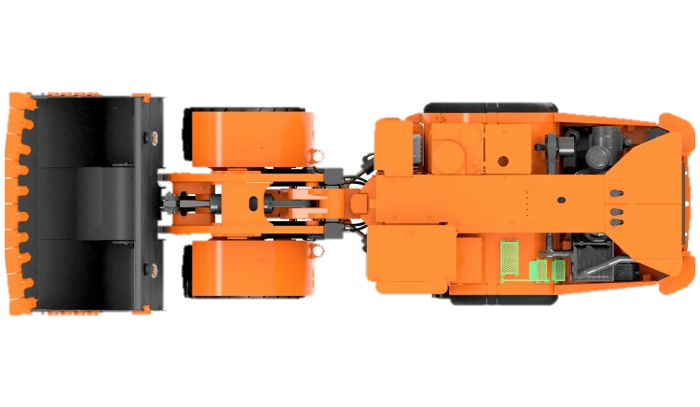
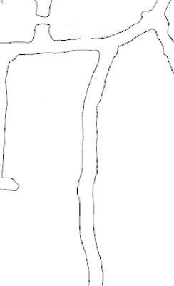
Scenario 3
Two vehicles approaching each other
LO –> A3 Alarm
RO –> A1 Awareness
LO –> A2 Alert
RO –> A3 Alarm
LO –> A1 Awareness
FINISHED
RO –> A2 Alert
ANIMATING
START ANIMATION
LO approaching RO in a roadway
Intention is for both vehicles to continue on straight course
Operating state of LO is visible to RO and vice versa
RO has A1 and LO has A1 Awareness on approach
Example Parameters to Consider:
Mass of the Machines
Operating Speed of Machines
Grade of the Drive
A2 Alert Triggered on entry of 1st Zone on both RO and LO
RO and LO Operator alerted to abnormal situation
A3 Alarm Triggered on entry of 2nd Zone on both RO and LO
Alarm notifies RO and LO Operator of imminent threat
Theoretical trigger for L9 Control
Common Variations
Head to Head, Head to Tail and Tail to Tail
RO is moving or stationary as LO Approaches
Underground tunnels are rarely perfectly straight. Consideration must be given for the constant change in shape of the tunnel.
Additionally, the tunnel may not be flat, but may dip or crest.

Slide 3
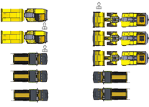
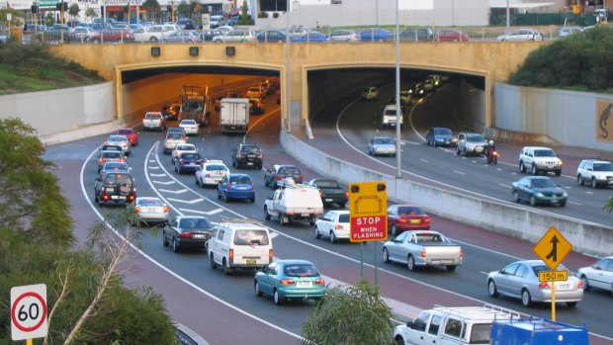
Failure Mode 2 – False Trigger
Congestion
LO –> A3 Alarm
FINISHED
ANIMATING
START ANIMATION
Multiple vehicles seeking to perform similar maneuver
Portal access, key intersection, go line exit
One or more LO’s approaching one or more RO’s
LO and RO has A1 Awareness on approach
Depending on level of proximity achieved by each vehicle
A2 Alert Triggered on entry of 1st Zone
LO Operator alerted to abnormal situation
A3 Alarm Triggered on entry of 2nd Zone
Alarm notifies LO Operator of imminent threat
Theoretical trigger for L9 Control
Congestion can occur at key locations in a mine where multiple vehicles are waiting to proceed.
Consideration should be given to allowing vehicles to queue in close proximity and move forward once able to.
Common Variations
Portal Access
Heavy Vehicle Go Lines
Light Vehicle parking bays
Key intersections through mine
Workshops and Maintenance Bays
Lunch rooms and Refuge Stations

Slide 4
End.
enquiries.org
emesrt.org

