Slide 1
Vehicle interaction control improvement project
Underground functional performance scenario storyboards
Scenario 4: Vehicle turning towards a Person / Equipment / Vehicle
Tier 1
Tier 2
EMESRT Members

Slide 2
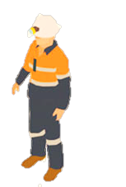
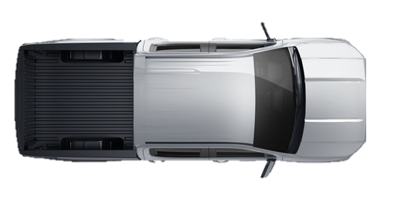
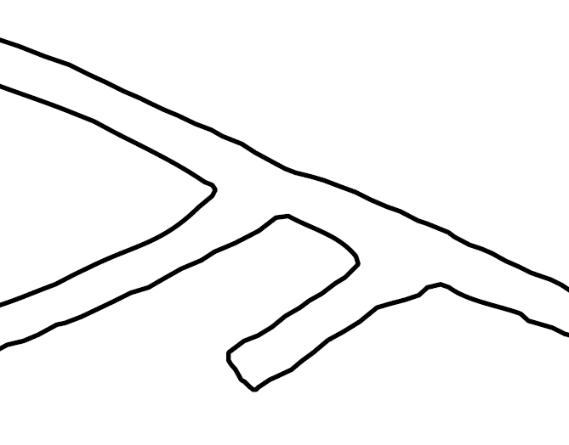
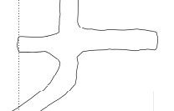
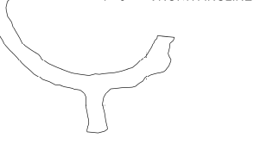
Scenario 4
Vehicle turning towards a Person / Equipment / Vehicle
LO –> A3 Alarm
LO –> A2 Alert
LO –> A1 Awareness
FINISHED
ANIMATING
START ANIMATION
LO approaching turn with pedestrian or LV (RO) in a roadway
Operating state of LO is visible to RO
RO A1 Awareness on approach
Example Parameters to Consider:
Mass of Machine
Operator Speed of Machine
Grade of the Drive
Turning speed of machine
or
A2 Alert Triggered on entry of 1st Zone as turn is initiated
LO Operator alerted to abnormal situation
A3 Alarm Triggered on entry of 2nd Zone as turn is continued
Alarm notifies LO Operator of imminent threat
Theoretical trigger for L9 Control
Turns are not always 90 degrees. Consideration must be given for turns that have acute angles
Common Variations
LO Reversing into RO through a turn
RO is moving as LO Approaches
T Intersection, Cross Intersection, Simple Sharp Turn
A turn point does not always occur on a straight path. Consideration must be given to the possibility that the machine was already performing a turn (to maintain tunnel direction) before the turn at the intersection.

Slide 3
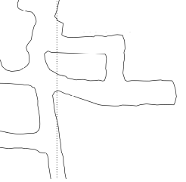
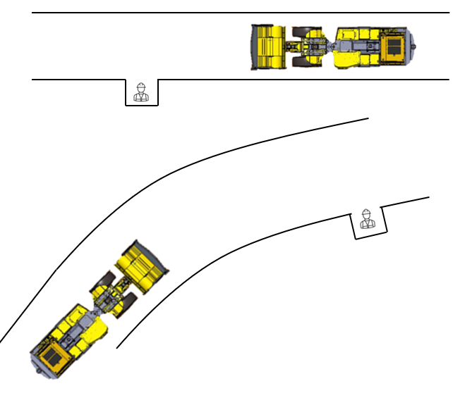
Failure Mode 3 – False Trigger
Vehicle passing occupied T-intersection
Intended Direction of Travel
LO –> A3 Alarm
LO –> A2 Alert
LO –> A1 Awareness
FINISHED
ANIMATING
START ANIMATION
LO approaching pedestrian or LV (RO) in a roadway
Intention is to continue on straight course
Operating state of LO is visible to RO
RO A1 Awareness on approach
or
Consideration should be given to vehicles passing in close proximity to areas that normally have pedestrians working.
Crib Room
False A2 Alert Triggered – Zone expanding into Intersection
LO Operator falsely alerted to normal situation
False A3 Alarm Triggered – Zone expanding into Intersection
Alarm falsely notifies LO Operator of imminent threat
Theoretical false trigger of L9 Control
Common Variations
LO Reversing past intersection
RO is moving as LO Approaches
Applicable to T Intersection, Cross Intersection or on a curved drive
Applicable to Crib Rooms, Workshops and Work Bays
Applicable to pedestrian safety bays
A turn point does not always occur on a straight path. Consideration should be given to the possibility that the machine was already performing a turn (to maintain tunnel direction) before the turn at the intersection.

Slide 4
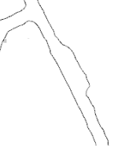
Failure Mode 4 – False Trigger
Vehicle passing occupied passing bay
Intended Direction of Travel
LO –> A3 Alarm
LO –> A2 Alert
LO –> A1 Awareness
FINISHED
ANIMATING
START ANIMATION
LO approaching vehicle in passing bay
Intention is to continue on straight course
Operating state of LO is visible to RO
RO A1 Awareness on approach
Example Parameters to Consider:
Mass of Machine
Operating Speed of Machine
Stopping Distance of Machine
Width of the Drive
False A2 Alert Triggered – Zone expanding into passing bay
LO Operator falsely alerted to normal situation
False A3 Alarm Triggered – Zone expanding into passing bay
Alarm falsely notifies LO Operator of imminent threat
Theoretical false trigger of L9 Control
Consideration must be made for the available space in the underground environment. Passing bays typically have sufficient room for two large vehicles and no more.
Common Variations
LO Reversing past intersection
RO is moving as LO Approaches
Applicable to curved drives

Slide 5
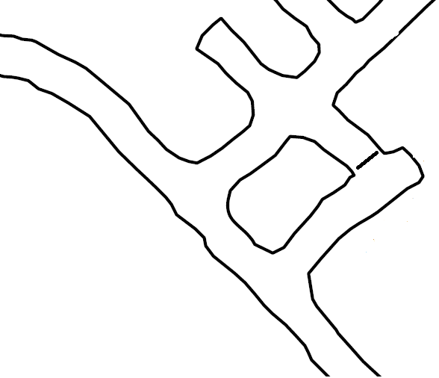
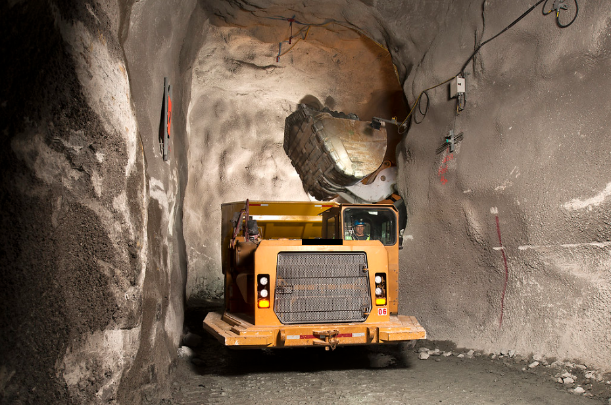
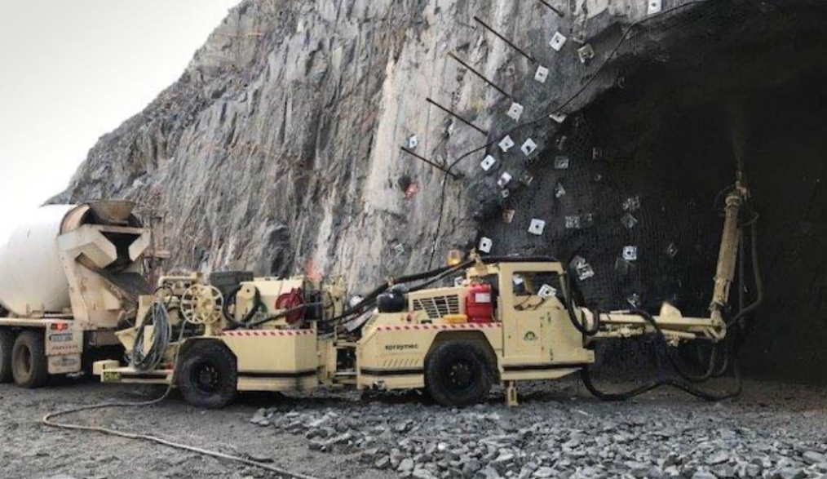
Failure Mode 5 – False Trigger
Vehicle deliberately approaching another vehicle
LO –> A3 Alarm
LO –> A2 Alert
LO –> A1 Awareness
FINISHED
ANIMATING
START ANIMATION
LO intentionally approaching RO in a roadway
Intention is to approach and stop at short proximity
Operating state of LO is visible to RO
RO A1 Awareness on approach
LHD
False A2 Alert Triggered
LO Operator falsely alerted to normal situation
LV
Truck
False A3 Alarm Triggered
Alarm falsely notifies LO Operator of imminent threat
Theoretical false trigger of L9 Control
Trucks can be loaded at the same grade or in dedicated Truck Loading Bays where the truck is lower than the loader. For the latter, consideration must be made for the normal circumstance where other vehicles can pass the truck.
Common Variations
LO is Reversing on approach
Applies to “at grade” loading and dissimilar grade loading
Truck can be loaded from side or rear
Common Examples
LHD loading a Truck
Agitator transferring to Shotcrete Spray Rig
Service Vehicle performing a service on HV
Fuel Truck approaching to Fuel
HV reversing to HV to attach for Towing

Slide 6
End.
enquiries.org
emesrt.org

