Slide 1
Vehicle interaction control improvement project
Underground functional performance scenario storyboards
Scenario 5: Vehicle approaching Environment hazard
Tier 1
Tier 2
EMESRT Members

Slide 2
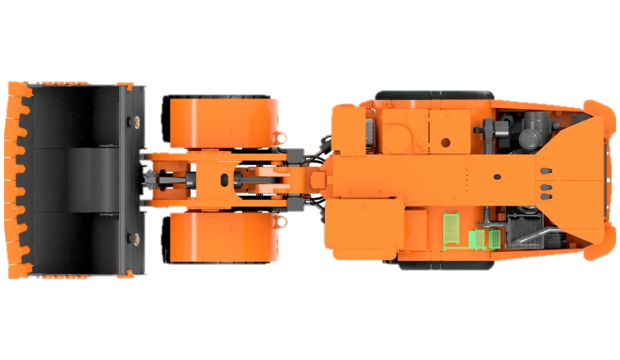
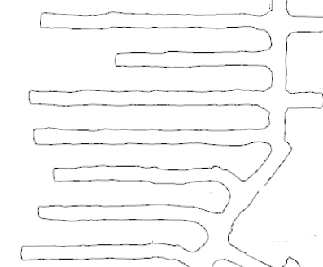
Scenario 5
Vehicle approaching Environment hazard
LO –> A3 Alarm
LO –> A2 Alert
LO –> A1 Awareness
FINISHED
ANIMATING
START ANIMATION
LO approaching hazard
RO A1 Awareness on approach
Example Parameters to Consider:
Mass of Machine
Operating Speed of Machine
Grade of the drive
A2 Alert Triggered on hazard entry of 1st Zone
LO Operator alerted to abnormal situation
A3 Alarm Triggered on entry of 2nd Zone
Alarm notifies LO Operator of imminent threat
Theoretical trigger for L9 Control
For mining operations that utilise Stope Extraction techniques, dangerous ground zones behind barricades are numerous, with multiples per level. Consideration must be given to the number of zones at the operation.
Common Variations
LO Approaching open stop or pass
LO approaching unsupported ground
LO approaching sump
LO approaching critical infrastructure such as electrical substations
LO approaching temporary installations (drills)

Slide 3
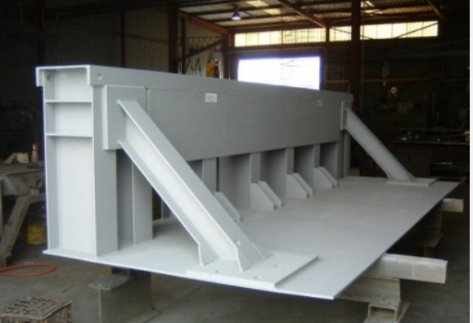
Failure Mode 6
Vehicle deliberately approaching hazard
LO –> A3 Alarm
LO –> A2 Alert
LO –> A1 Awareness
FINISHED
ANIMATING
START ANIMATION
LO is intentionally approaching hazard to perform work
RO A1 Awareness on approach
For mining operations that utilise Stope Extraction techniques, stop logs are numerous and portable, being shifted from stope to stope at the completion of backfill. Backfill activities can have a short duration, measured in days.
False A2 Alert Triggered
LO Operator falsely alerted to normal situation
False A3 Alarm Triggered
Alarm falsely notifies LO Operator of imminent threat
Theoretical false trigger of L9 Control
Common Variations
LO approaching tipping point with stop log or grizzly
LO approaching dangerous ground to park or give way to another vehicle
LO mucking out sump

Slide 4
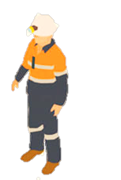
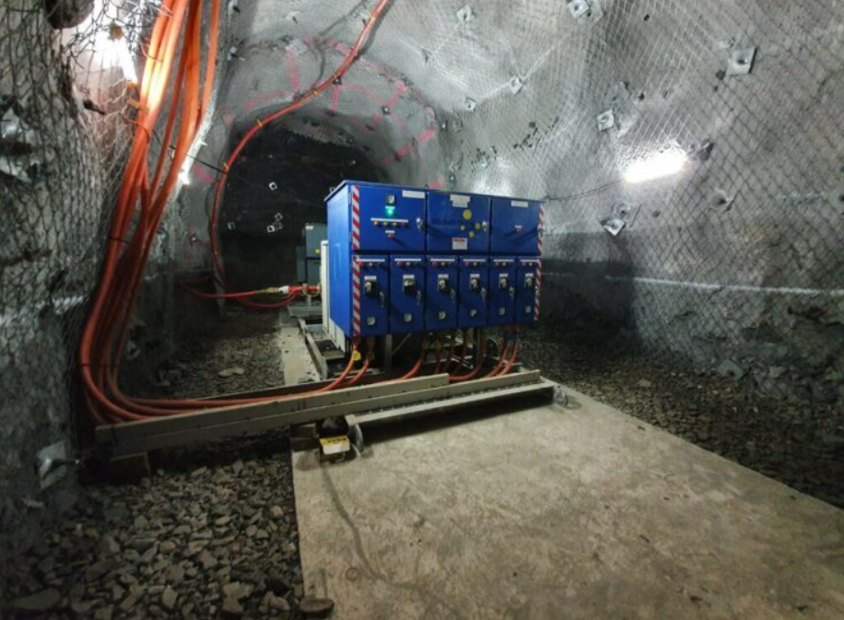
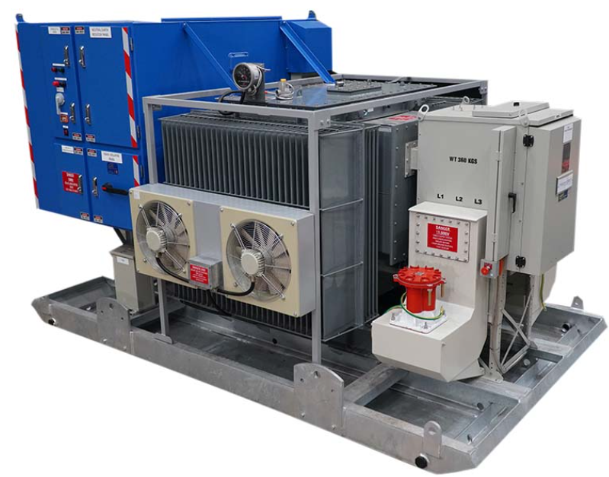
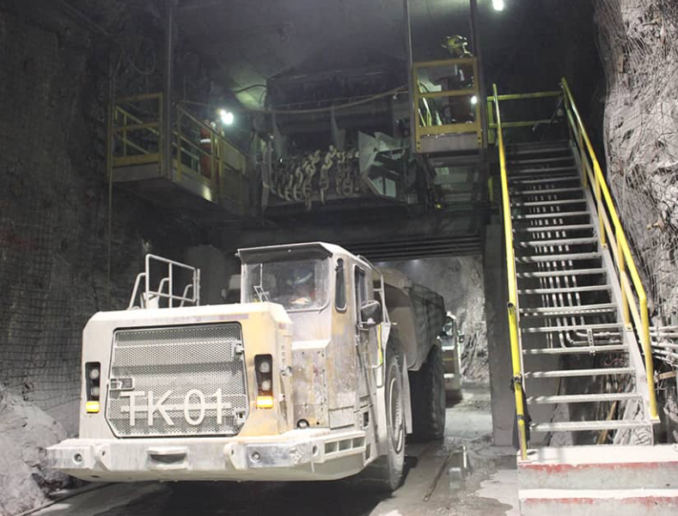
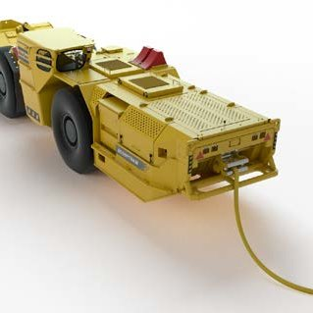
Failure Mode 7
Infrastructure or mobile vehicle effects on sensor capabilities
No Alarm
FINISHED
ANIMATING
START ANIMATION
LO approaching pedestrian or LV (RO) in a roadway
RO is in close proximity to infrastructure
Infrastructure influences sensor systems on LO
Operating state of LO is visible to RO
LO does not receive A1 Awareness on approach
A2 Alert or A3 Alarm are not triggered
Common Variations
LO operating near electrical infrastructure
LO operating near significant steel structure
LO operating in ore body with high levels of metals
Consideration should be made for the effects that battery electric or hybrid vehicles may have on certain sensor types.
Consideration should be made for the types of infrastructure underground that may affect certain sensor types.

Slide 5
End.
enquiries.org
emesrt.org

