Slide 1
Vehicle Interaction Control Improvement Project
Vehicle Interaction Knowledge Hub Resource - Story Board Series
Scenario 1: Segregated Roads
Version October 2020

Slide 2
Adapting and Using EMESRT Story Boards
What are they?
The Story Board approach was developed by an EMESRT Member Company to assist with the specification and installation of Proximity Detection Systems (PDS) on mobile equipment at surface mines
They provide a visual and dynamic reference for equipment operators, PDS suppliers VI Control Improvement project managers as they implement VI intervention controls (EMESRT Levels 8–9)
How can I use them?
Review each Story Board in presentation mode
As required, adapt the resource to your circumstances
Use the Story Boards as a resource during Phase 4 - New Technology Implementation

Slide 3
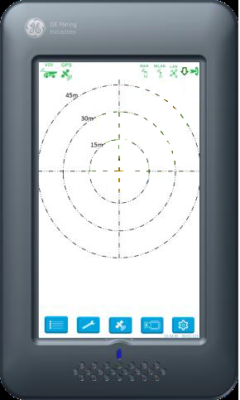
Segregated Roads
LV’s Only
Geofence is created to prevent specified unauthorized LOs (vehicle type) to enter a specific road in the mine –
Awareness - When LO’s outer beam breaches the No Go zone/geofence, then the CAS screen will brighten and No Go Zone icon will appear
Alert – If the LO’s inner beam breaches the No Go zone/geofence an in cab verbal prompt will be triggered ”No-Go Zone Ahead”
Alarm - If the LO’s body breaches the No Go zone/geofence an in cab verbal prompt will be triggered ”No Go Zone Breach”
Prompt will continue until vehicle exits the zone
“NO-GO ZONE AHEAD”
“ZONE BREACH”

