Slide 1
Vehicle Interaction Control Improvement Project
Vehicle Interaction Knowledge Hub Resource - Story Board Series
Scenario 11: Passing Roadworks Vehicles
Version October 2020

Slide 2
Adapting and Using EMESRT Story Boards
What are they?
The Story Board approach was developed by an EMESRT Member Company to assist with the specification and installation of Proximity Detection Systems (PDS) on mobile equipment at surface mines
They provide a visual and dynamic reference for equipment operators, PDS suppliers VI Control Improvement project managers as they implement VI intervention controls (EMESRT Levels 8–9)
How can I use them?
Review each Story Board in presentation mode
As required, adapt the resource to your circumstances
Use the Story Boards as a resource during Phase 4 - New Technology Implementation
Remember LO = Local Object and RO = Remote Object (reference EMERST PR5A)

Slide 3
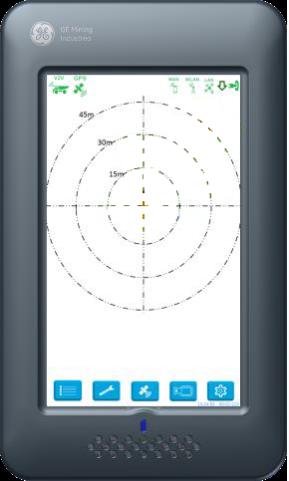
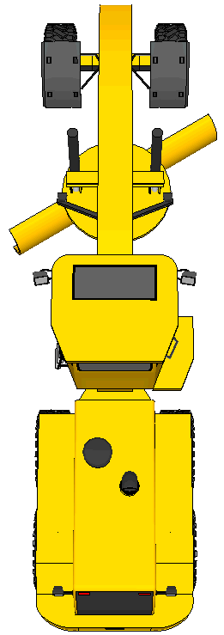
Passing Roadwork Vehicles
RO (Grader) will have two zones when performing roadworks
30 Kph speed limit radius large enough to cover both sides of the road in order to reinforce LO’s to maintain speed through road works area
5m additional body width on each side of the RO (Grader) to reinforce to LO’s to maintain 5m clearance whilst passing the grader
30 Kph Road Works Zone –
When LO (Haul Truck) outer beam breaches the radius of the road works zone at X% above the speed limit the CAS display will brighten and display icons related to speed and roadworks
When LO inner beam breaches the radius of the road works zone at X% above the speed limit the CAS UI will give a verbal prompt ”Road Works Ahead”
When LO body breaches the radius of the road works zone at X% above the speed limit the CAS UI screen will give the verbal prompt “Reduce Speed” (same as normal speeding prompt)
No awareness, alerting or alarming in the RO (Grader)
5m Body Zone of Roadworks Equipment –
When LO (Haul Truck) inner beam breaches the 5m zone CAS display will brighten in the LO and a verbal prompt “Maintain Clearance”
When LO body breaches the 5m zone of the road works vehicle the verbal prompt “Breach or Body Breach” in both vehicles
No awareness or alerting will occur in the RO (Grader), unless the LO’s body breaches RO’s 5m zone
For speeding - not applicable for wheel loaders, dozer, grader, light vehicles, drills, medium vehicles, cable reelers and tracked loading units
For body zone - not applicable for light vehicles, drills, medium vehicles and tracked loading units
30 Kph
5m
5m
“ROADWORKS AHEAD”
RO = Grader, Dozer, Scraper & Loader LO = Haul Trucks, Fuel Trucks & Water Trucks

