Slide 1
Vehicle Interaction Control Improvement Project
Vehicle Interaction Knowledge Hub Resource - Story Board Series
Scenario 2: Speed Zones General (also applies to ramps)
Version October 2020

Slide 2
Adapting and Using EMESRT Story Boards
What are they?
The Story Board approach was developed by an EMESRT Member Company to assist with the specification and installation of Proximity Detection Systems (PDS) on mobile equipment at surface mines
They provide a visual and dynamic reference for equipment operators, PDS suppliers VI Control Improvement project managers as they implement VI intervention controls (EMESRT Levels 8–9)
How can I use them?
Review each Story Board in presentation mode
As required, adapt the resource to your circumstances
Use the Story Boards as a resource during Phase 4 - New Technology Implementation

Slide 3
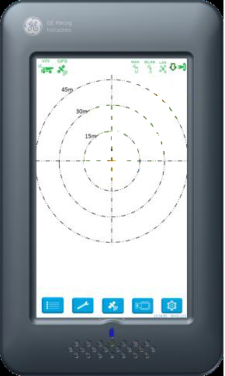
Speed Zones – General (also applies to ramps)
Awareness – not required
Alert – If the LO’s speed is above X% (i.e. 10%) when the inner beam breaches the speed zone/geofence the screen will brighten, and an in-cab verbal prompt will be triggered ”Speed Zone Ahead”. If the vehicle is travelling below the required speed no prompts will occur
Alarm - If the LO’s speed is still above X% (i.e. 10%) when the body of the LO breaches the speed zone/geofence an in-cab verbal prompt will be triggered “Reduce Speed or Check Speed”
Prompt will continue until speed is within tolerance
Grace period of X seconds (i.e. 5-10 secs) will be given to operator to get speed within tolerance prior to speeding fine issued
Not applicable for dozers, drills, graders, scrapers, LVs and tracked loading units
40 Kph
60 Kph
60 Kph
“SPEED ZONE AHEAD”
“SPEED ZONE AHEAD”

