Slide 1

VEHICLE INTERACTION CONTROL IMPROVEMENT
Surface Functional Performance Scenario Storyboards

Slide 2
What are scenario storyboards?
The Functional Performance Scenario Storyboard approach was developed by an EMESRT Member Company to better understand the fatal vehicle interaction scenarios in a surface mine and to then compare the capability of vehicle interaction technologies to mitigate or eliminate the exposures detailed in the storyboards. This has enabled designers to better develop and install vehicle interaction technologies appropriate mobile equipment interactions at surface mines and recently adapted for Underground mines
They provide a visual and dynamic reference for equipment operators, technology suppliers, Vehicle Interaction Control Improvement project managers as they implement vehicle interaction intervention controls (EMESRT Levels 7, 8 and 9)
How can I use the scenario storyboards?
Once downloaded, review each Storyboard in presentation mode
Use the Storyboards as a resource during Phase 4 – Vehicle Interaction Control Enhancement
As required, apply the specific scenario storyboards in your functional performance environment context to derive the configuration settings
Generally, in the storyboards these definitions apply:
LO = Local Object (causing the interaction)
RO = Remote Object (affected by the interaction)
Adapting and Using the Storyboards

Slide 3
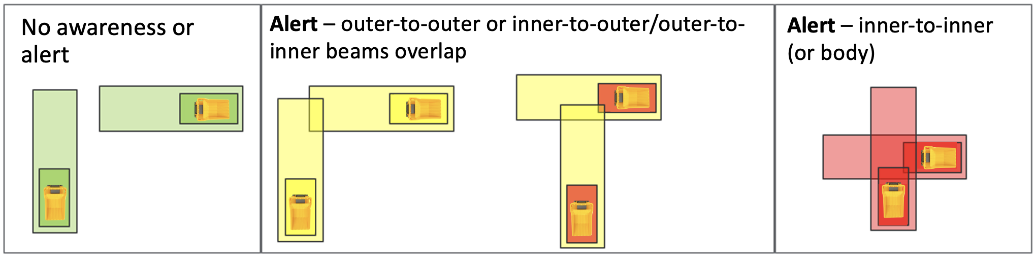
User interface behaviour – vehicle to vehicle interaction
Nil Interaction
No VI event audibles
No detection beams visible
Alert
Occurs when outer to outer or inner to outer/outer to inner beams on two vehicles intersect
User interface zooms to the interaction
Detection beams on both vehicles turn yellow then red
Default audible message of “Alert” is activated, definitive audibles used for specific VI scenarios
Audible played twice then a 3 second gap and repeated until situation rectified
Audible played at 5 dB above ambient noise
Alarm
Occurs when inner beam intersects with inner beam or body of another vehicle
User interface remains bright and zoomed to the interaction
Detection beams on both vehicles remain red
Default audible of “Shrill”, “Stop”, definitive audibles used for specific VI scenarios
Audible without the “Shrill” repeated with 1.5 second gap until situation rectified
Audible played at 10 dB above ambient noise
NOTE: the text in red provides examples of parameters that should be considered during development and site configuration.

Slide 4

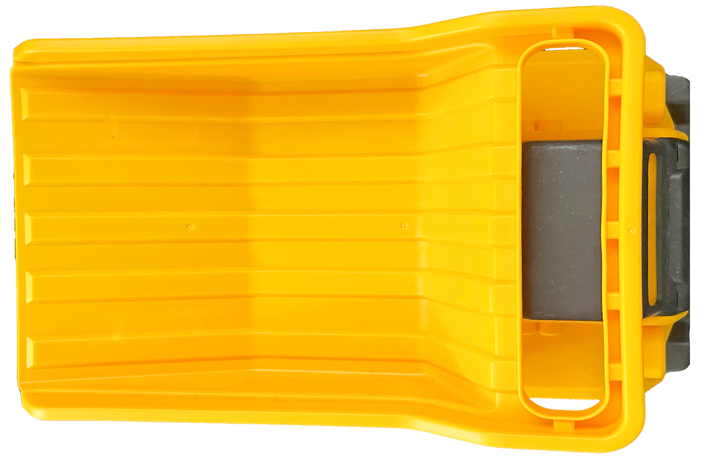
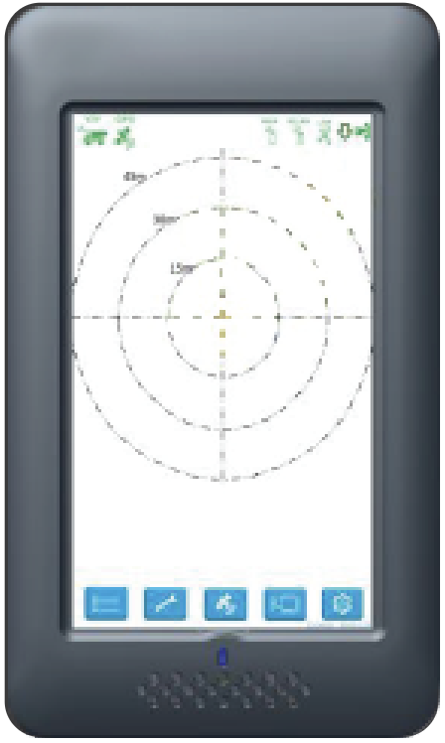




Scenario 3: Wet roads due to overwatering
RO (Water Cart) enables its watering system within the wet road’s geo-fence which activates the geo-fence
When the outer beam of an LO breaches the edge of the “Wet Road” geo-fence the user interface will brighten, and two prompts will be presented to the LO:
  An icon appears indicating road has been watered ahead
  Audible message of “Wet road ahead” will activate once only
Parameters
  Wet road geo-fence remains detectable for a configurable time limit
  Icon remains displayed on LO CAS user interface until:
    LO leaves activate geo-fence
    The geo-fence timeout expires
Dependencies:
  Water Cart and all other equipment will have to communicate with the server in real-time throughout the mine site
  Not applicable for wheel loaders, dozers, graders, drills, scrapers, cable reelers, and tracked loading units.
LO = Haul Trucks, LV’s & Service Trucks @ >15 kph
NOTE: the text in red provides examples of parameters that should be considered during development and site configuration.

