Slide 1














Vehicle interaction control improvement project
Underground functional performance scenario storyboards
Scenario 2: Vehicle moving towards an object
Tier 1
Tier 2
EMESRT Members

Slide 2

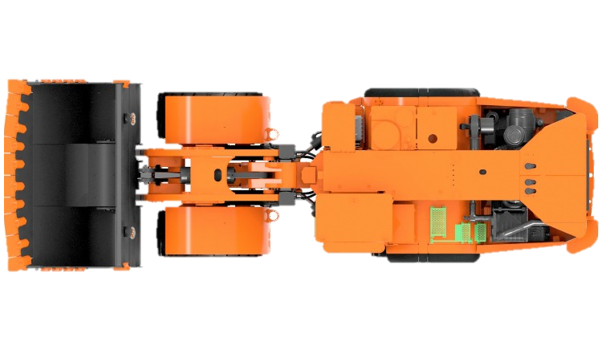

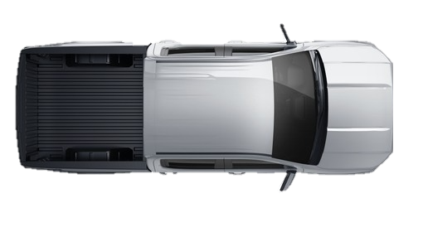
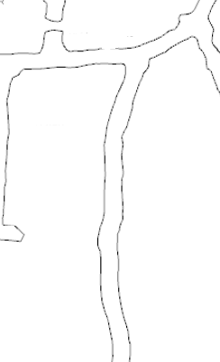
Scenario 2
Vehicle moving towards an object
or
LO –> A3 Alarm
LO –> A2 Alert
LO –> A1 Awareness
FINISHED
ANIMATING
START ANIMATION
LO approaching pedestrian or LV (RO) in a roadway
Operating state of LO is visible to RO
RO has A1 Awareness on approach
Example Parameters to Consider:
Mass of Machine
Operating Speed of Machine
Grade of the Drive
A2 Alert Triggered on entry of 1st Zone
LO Operator alerted to abnormal situation
A3 Alarm Triggered on entry of 2nd Zone
Alarm notifies LO Operator of imminent threat
Theoretical trigger for L9 Control
Inactive Vehicle
Consideration should be given to the variation of this scenario involving a pedestrian behind an inactive vehicle. The LO should still detect the RO behind the vehicle and ensure that the inactive vehicle is not “pushed” onto the RO.
Common Variations
LO Reversing into RO
RO is moving as LO Approaches
LO approaching a workshop or service bay
Underground tunnels are rarely perfectly straight. Consideration must be given for the constant change in shape of the tunnel. Additionally, the tunnel may not be flat, but may dip or crest.

Slide 3

End.
enquiries.org
emesrt.org

